Slide 1
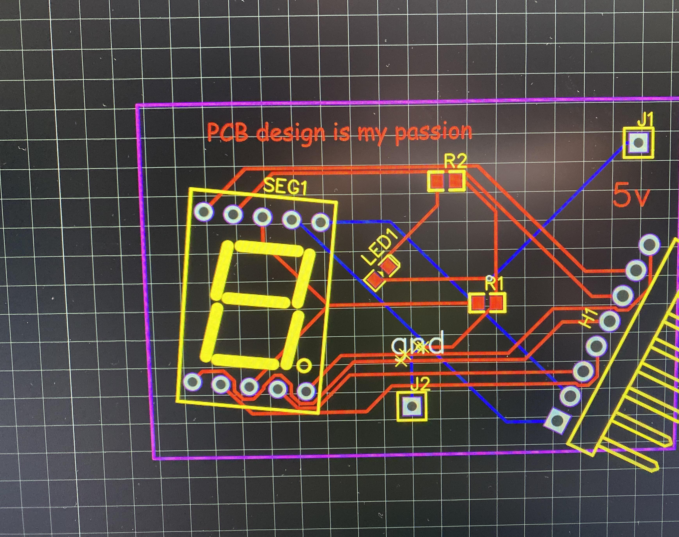
From zero to PCB hero
A small intro to KiCad

Slide 2
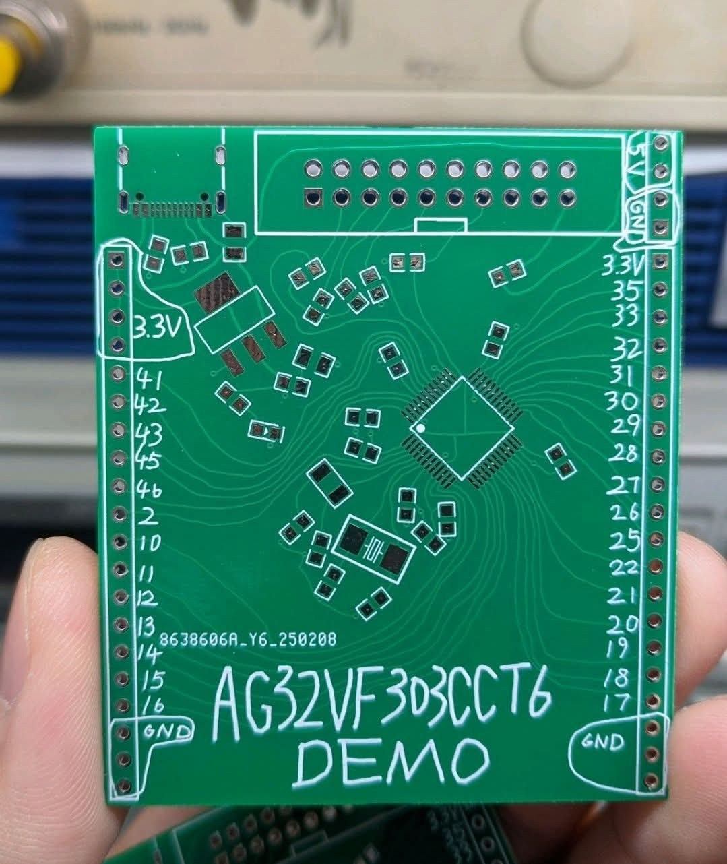
The plan for today
Get KiCad installed
Baby's first KiCad project
Exporting for manufacture
Organizing large projects
Best practice, cheatsheets and all that good stuff

Slide 3


The important questions
Where is it?
What is it?
Why should we use it?

Slide 4
Where is KiCad?
https://www.kicad.org/download/

Slide 5
What is KiCad?
Schematic design
PCB design
Bill of materials
Simulation
Much much more

Slide 6
Why is KiCad?
No license needed
Open source
Runs on every operating system
It's Free!

Slide 7
The design flow in broad terms
Schematic
Pcb layout
(Crying because you forgot footprints)
More Pcb layout
Ordering / Routing yourself
Finished physical pcb

Slide 8
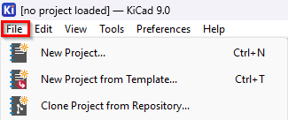
Setting up a new KiCad project
Empty project
From template
Clone from Repository

Slide 9
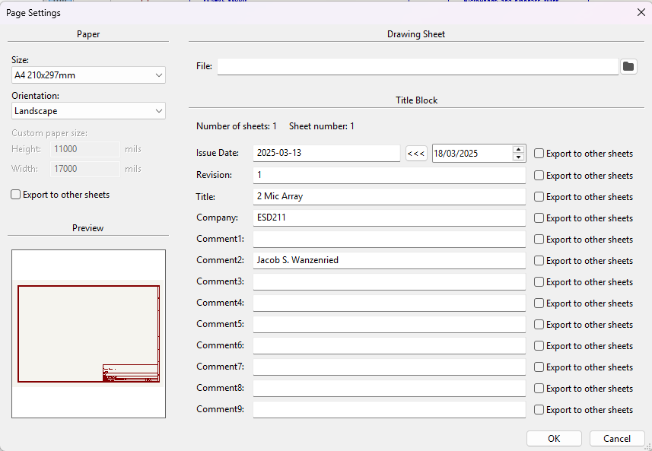
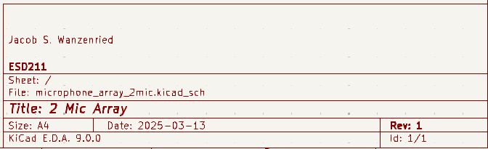
Schematic setup

Slide 10
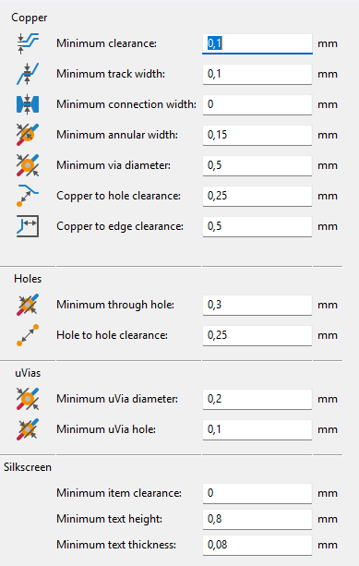
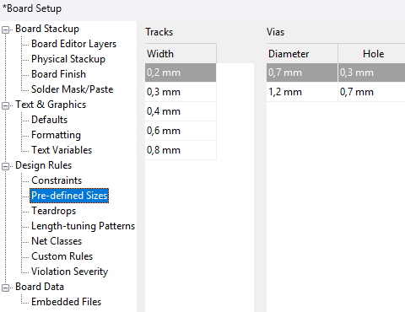
PCB setup
Board layers
Routing constraints
Track and via sizes
Net classes
And much more...

Slide 11
Simple buck converter with LM2575
A small starter project

Slide 12
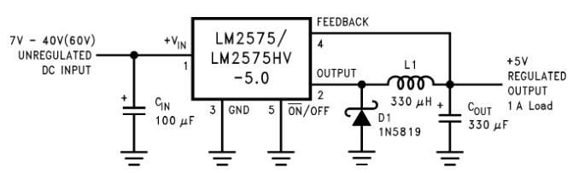
Only 5 components ☺
https://www.komponenten.es.aau.dk/fileadmin/komponenten/Data_Sheet/Spaendingsreg/LM2575.pdf

Slide 13
Let us go into KiCad
But first, a 3.14 minute break

Slide 14
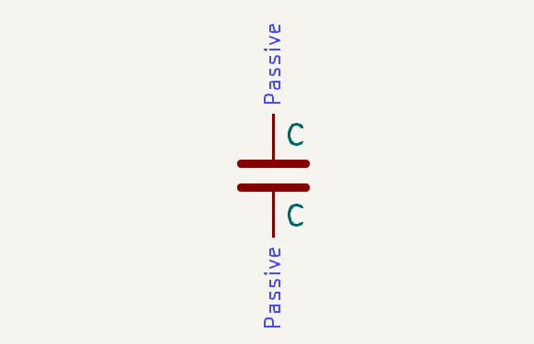
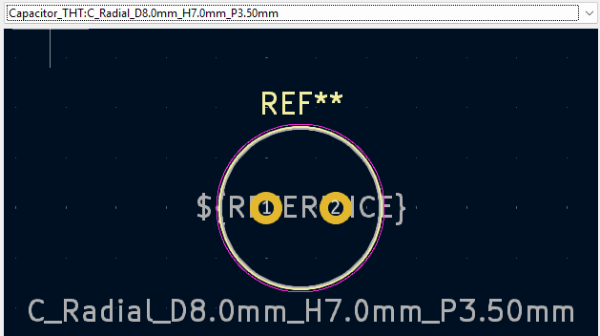
Inserting a symbol
Press A
Search for the symbol/part you want to insert
Remember to select a footprint

Slide 15
Schematic editor shortcuts
A – place component
W – draw connection
P – place power label
L – place local label
Ctrl+L – place global label

Slide 16
Pcb editor shortcuts
V – Switch between top/bottom layer
F – move selected to other layer
X – Route single track
U – select whole track
B – Recalculate all filled zones

Slide 17
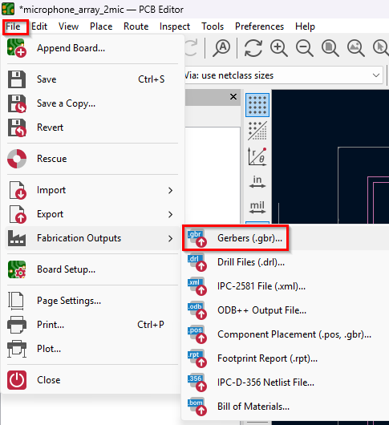
Exporting your board for production
In-house fabrication
Ordering

Slide 18
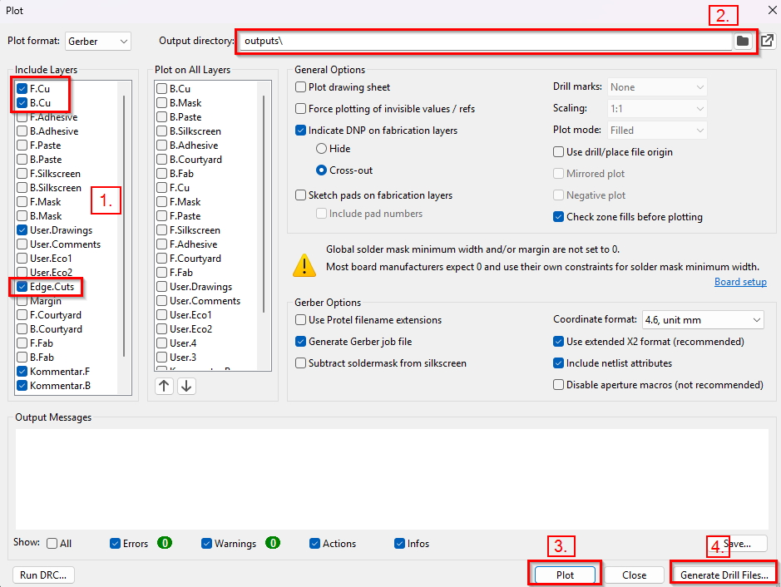
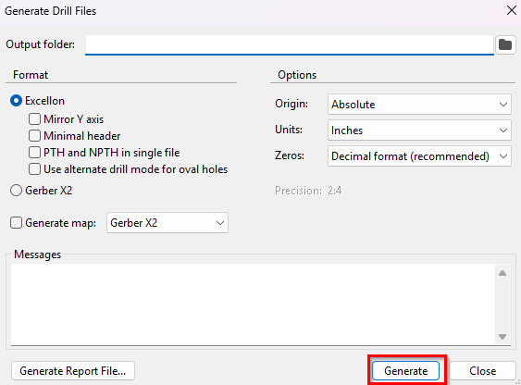
In-house

Slide 19
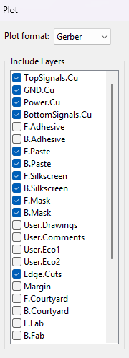
Ordering
Same procedure, but more options can be exported
Check exported files using JLCDFM before ordering
https://jlcdfm.com/

Slide 20
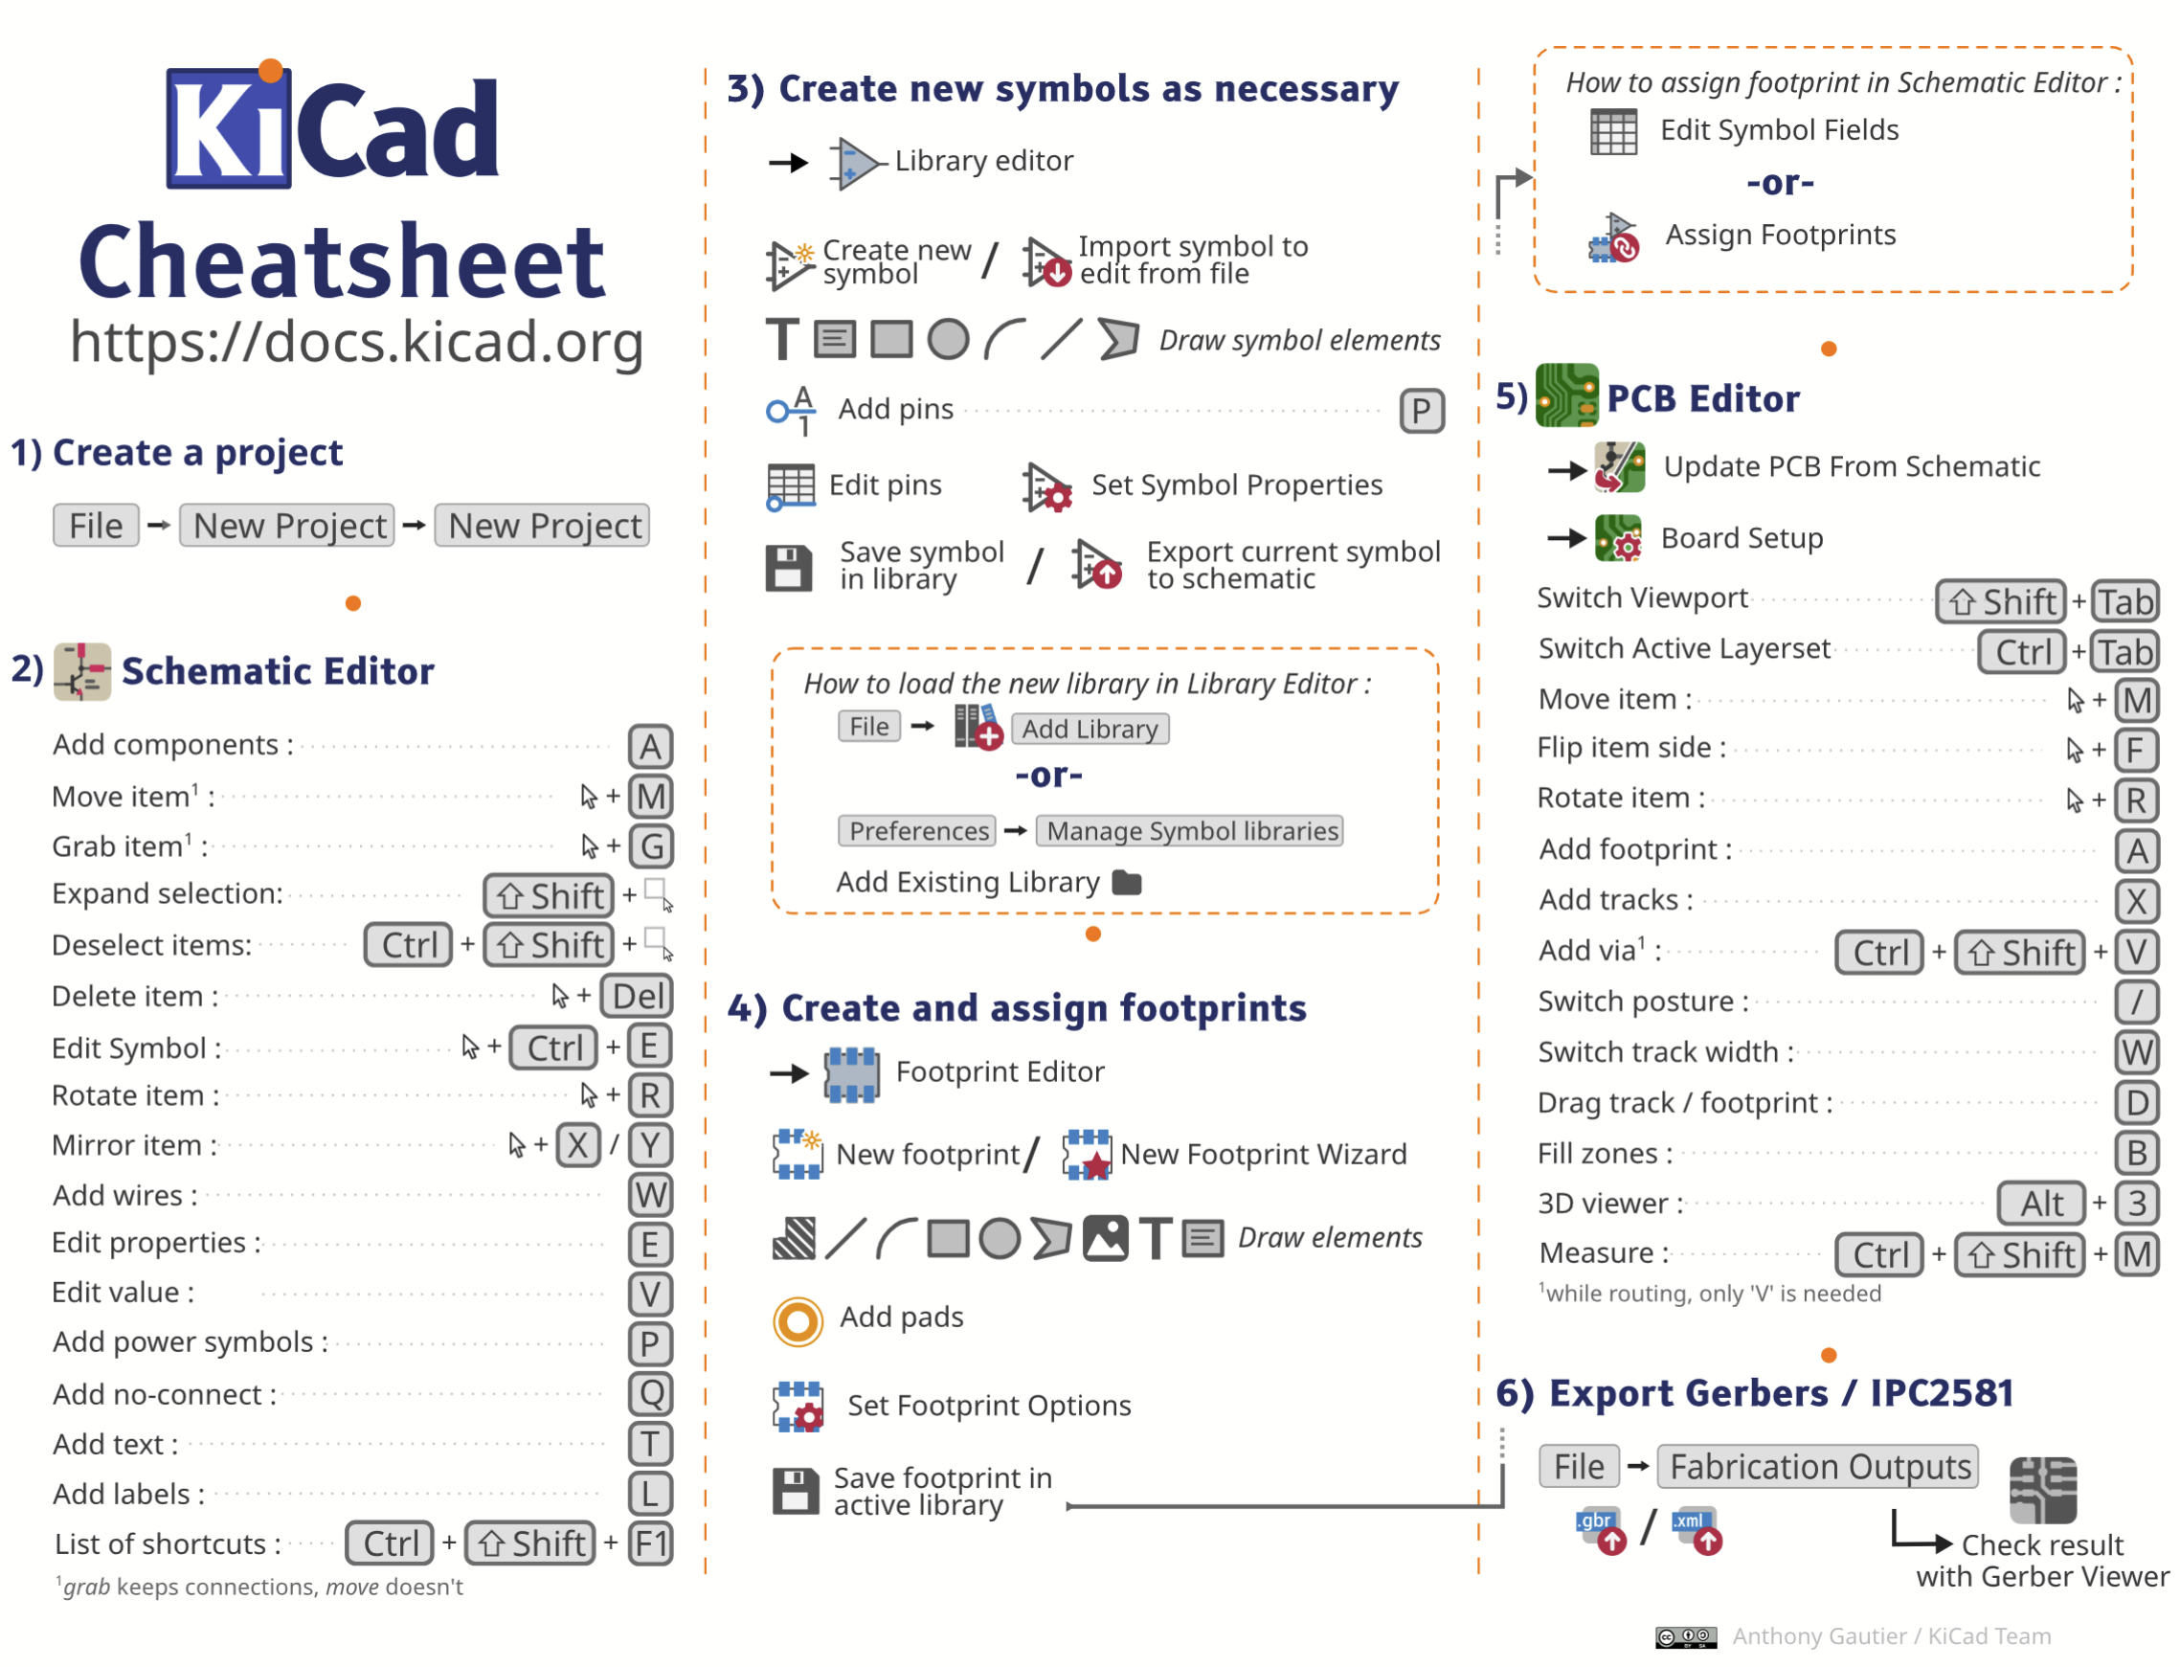
Kicad Cheatsheet
https://forum.kicad.info/t/kicad-v8-cheatsheet/51774

Slide 21
PCB design pitfalls
Always use as wide a trace as possible
0.4 mm / 0.6mm is ideal for traces
Every component/IC/Transistor/Regulator should be decoupled using a 1-100n capacitor
Except some rare cases
The goal is to get the shortest path for every trace from A to B
Good PCB-design Requires a certain level of OCD
Proper PCBs
Our homemade PCBs

Slide 22
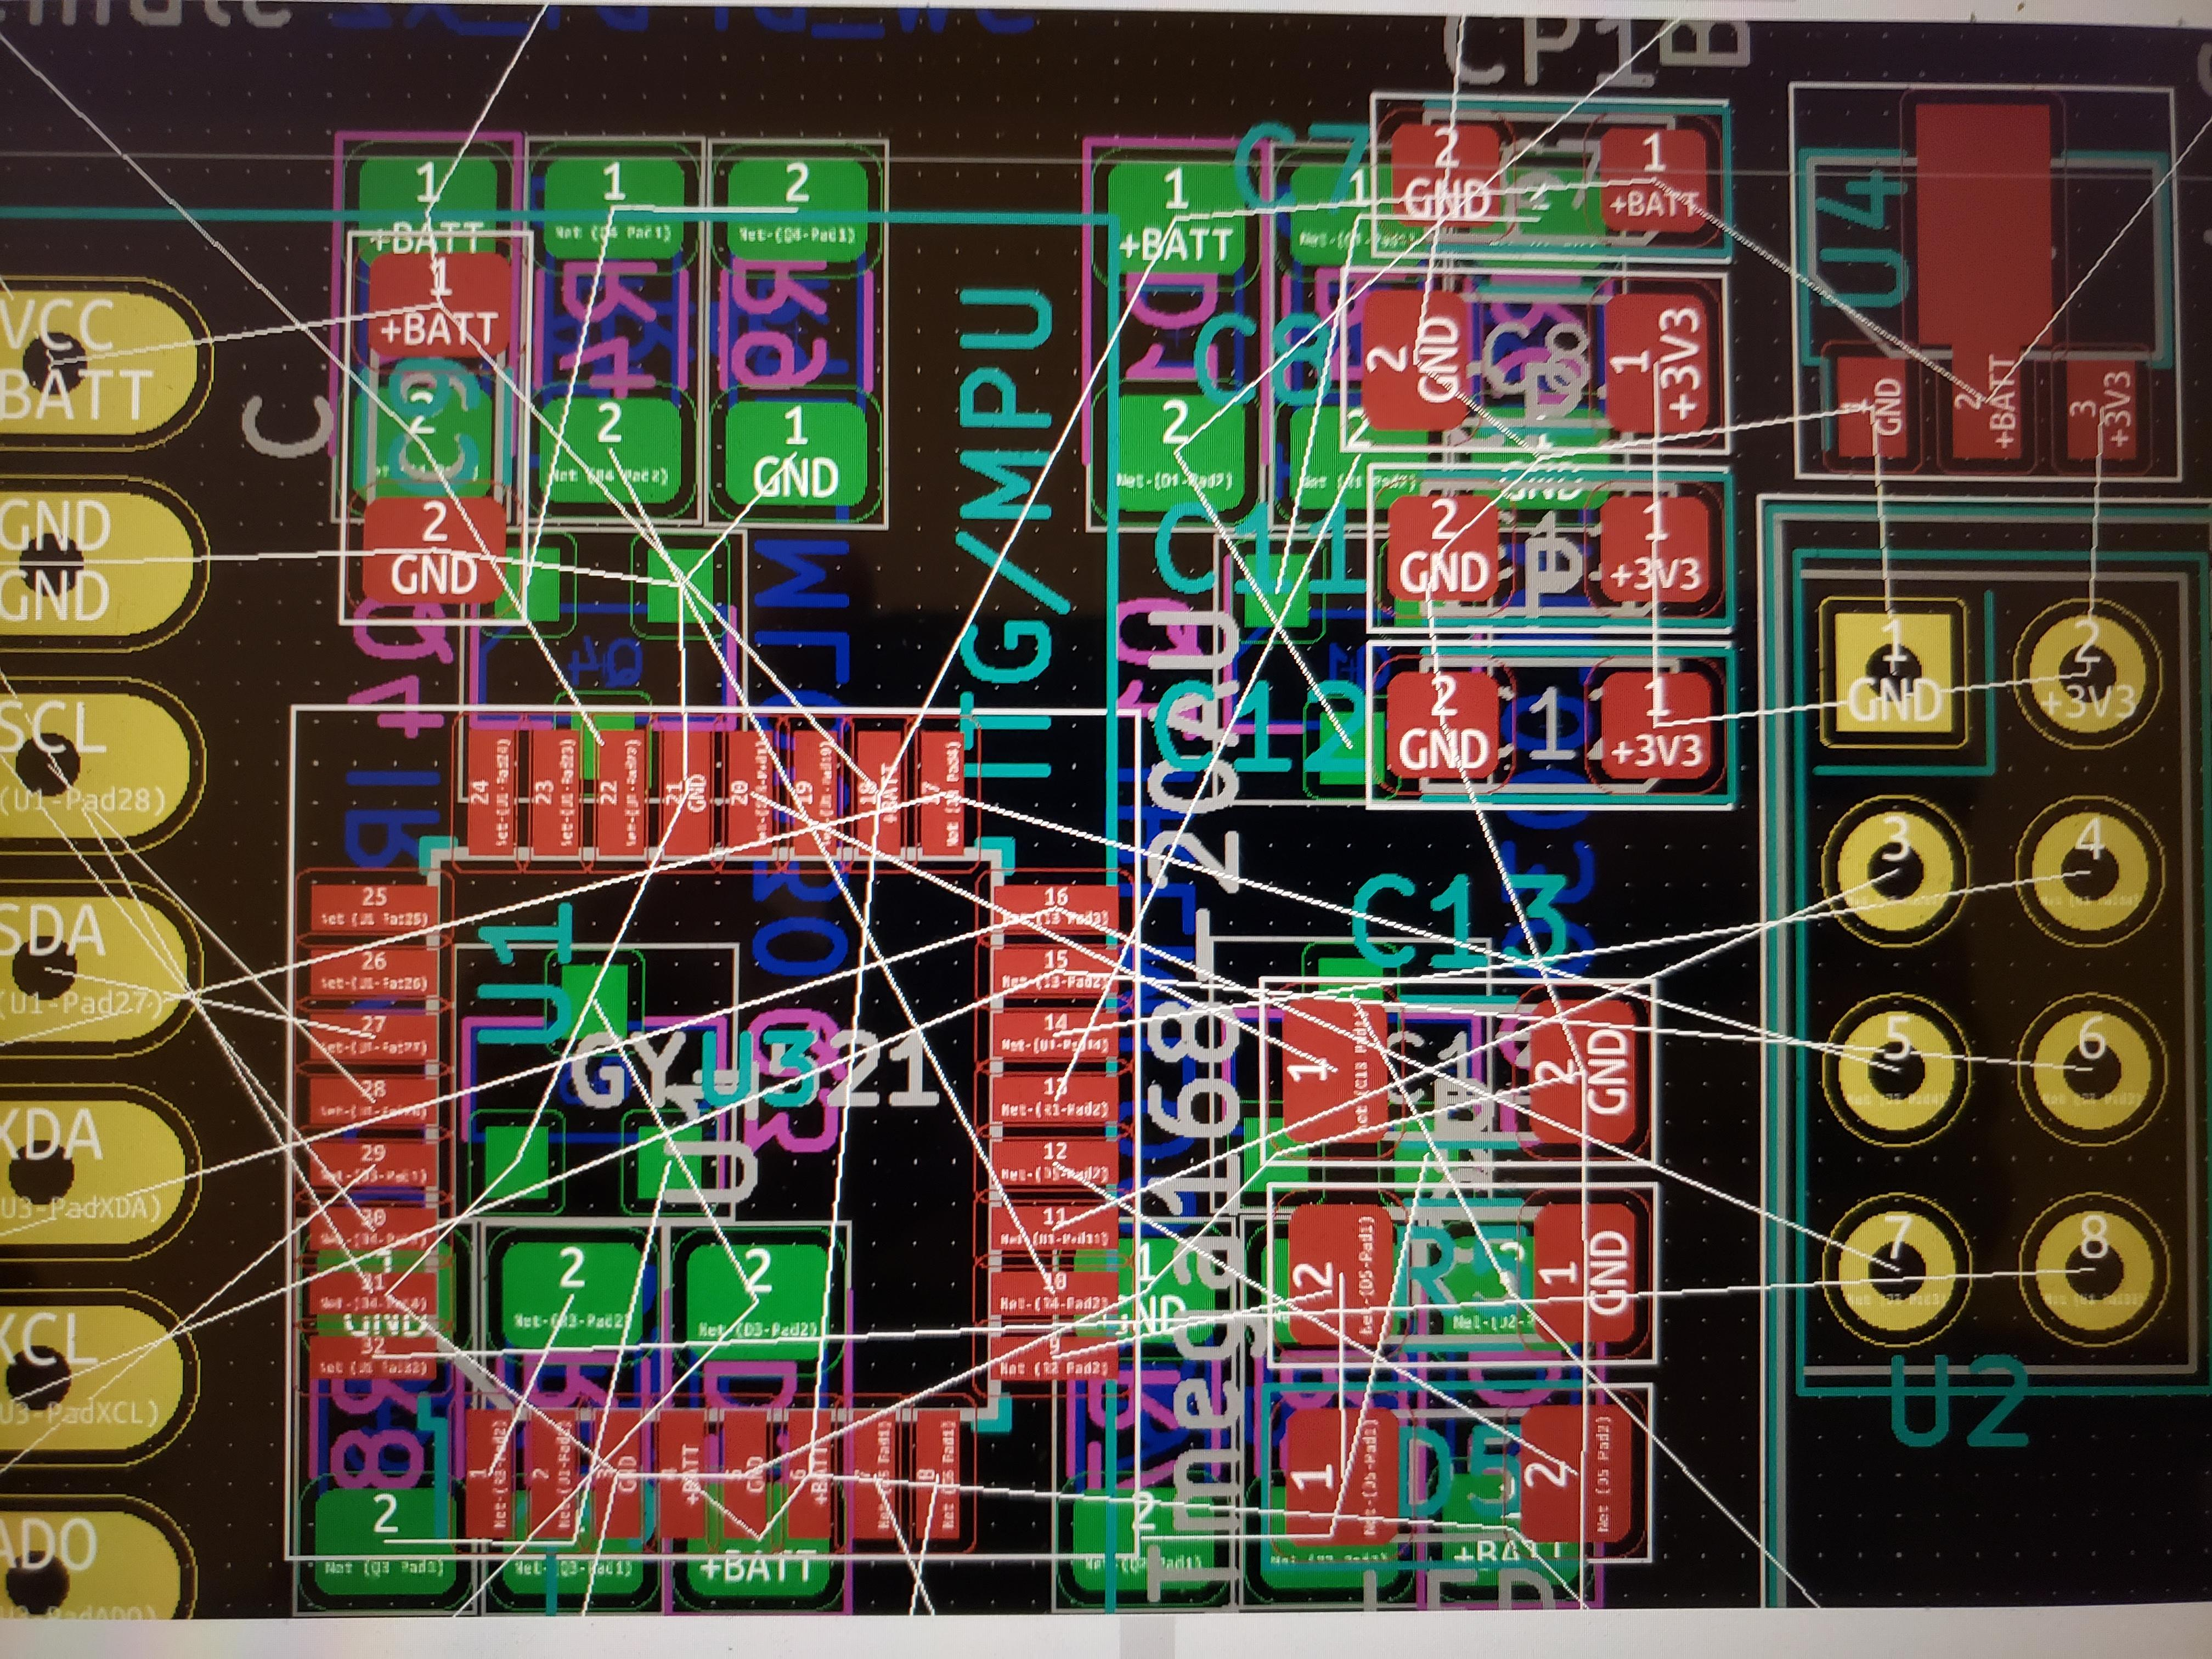
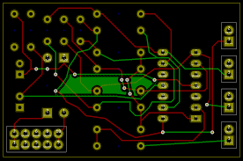
Examples – what not to do
A project doomed from the start
”You already paid for all the copper so you
might as well use it” – Axel Olsson

Slide 23
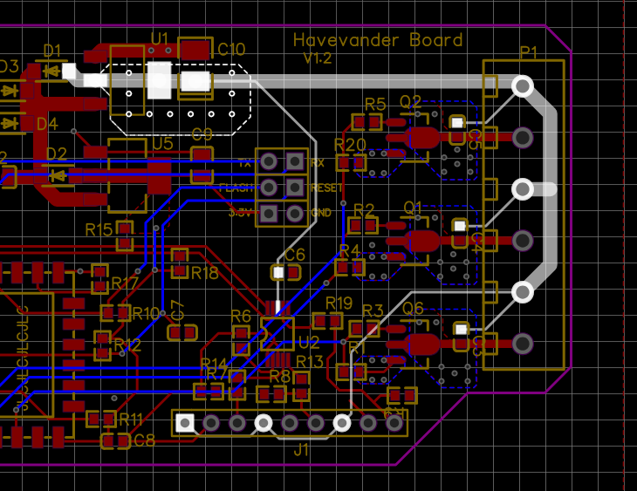
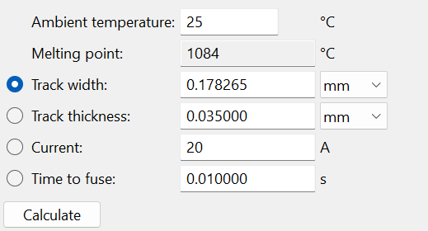
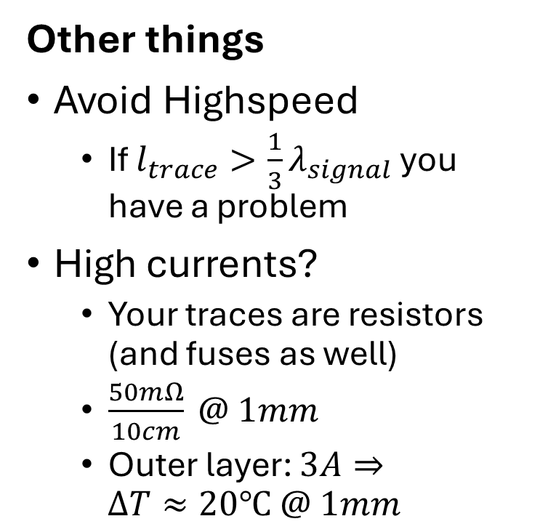
Examples – what not to do
Other things
Avoid Highspeed
If $l_{trace}>\frac{1}{3}λ_{signal}$ you have a problem
High currents?
Your traces are resistors (and fuses as well)
$\frac{50mΩ}{10cm} @ 1mm$
Outer layer: $3A⇒$
$$ΔT≈20℃ @ 1mm$$
Looks pretty good
O_o
So thin?
No decoupling!?
A garden pump controller
Designed by yours truely (It never worked that well)

Slide 24

BREAK TIME

Slide 25
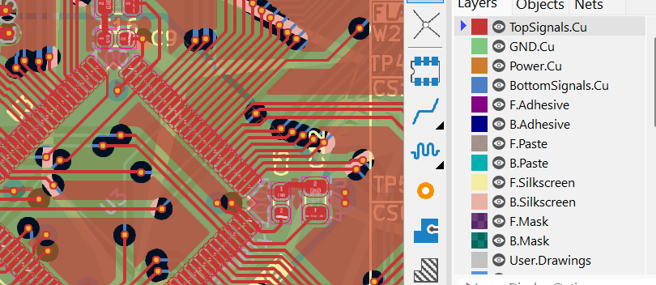
Power and Ground stackup
Life is short, use 4 layer for ”real” pcb’s

Slide 26
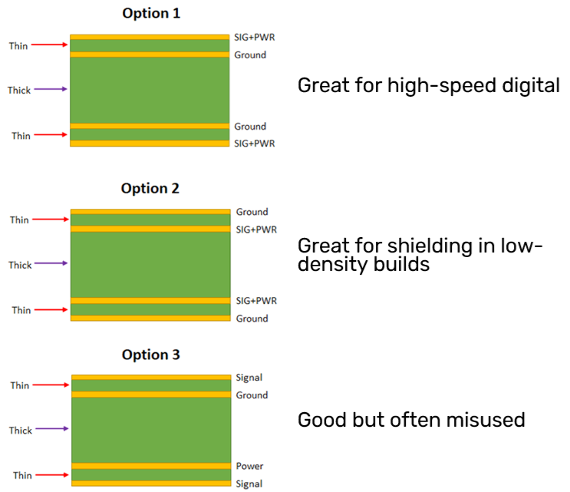
Source: https://resources.altium.com/p/4-layer-pcb-stackup

Slide 27
Organizing larger projects
Building on Ben’s lovely PCB course
Hierchal sheets
Pin management
Vector/Group Busses

Slide 28
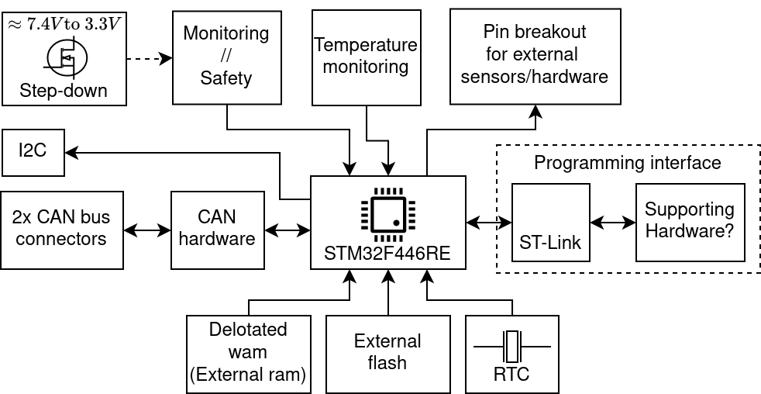
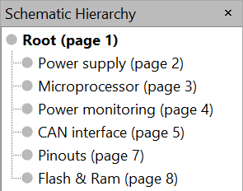
Hierarchical design
Splitting the board into functionalities
STM32H7B0VBT

Slide 29
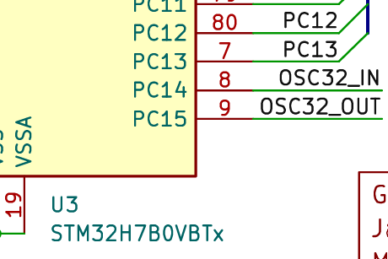
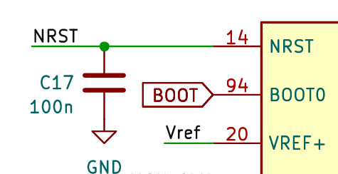
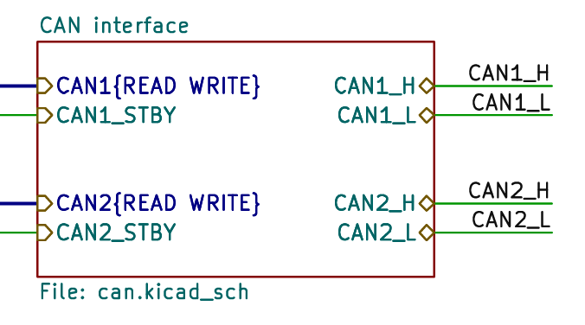
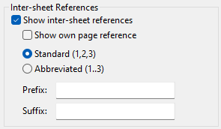
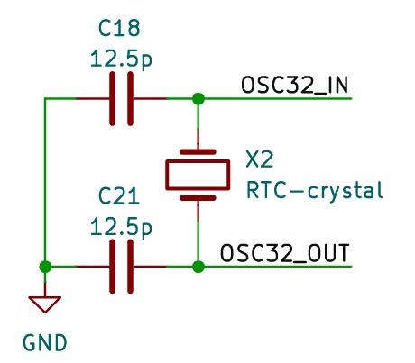
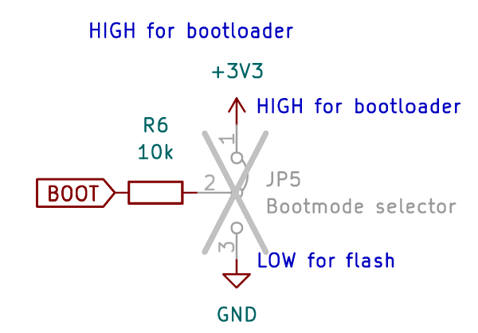
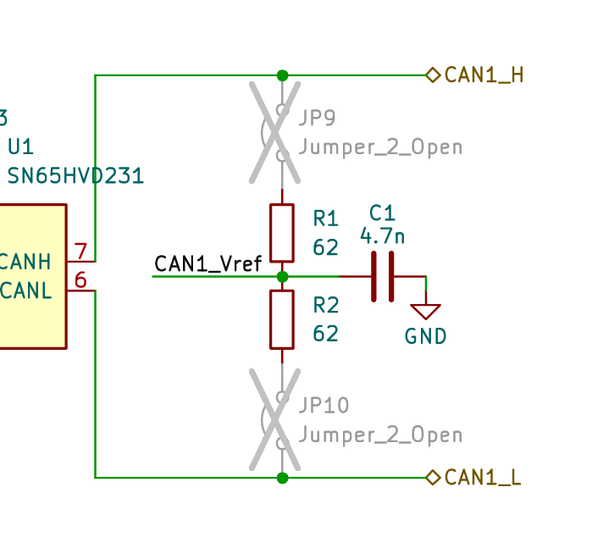
Hierarchical design – interfaces
The pin connectors
Local labels
Global labels
Hierachal label
Use for local connections local sheet only
Global variable across all sheets – Shares properties with ”power” labels
Makes a pin visible on the hierachy block
Source: https://docs.kicad.org/master/en/eeschema/eeschema.html
This one is different well come to him later

Slide 30
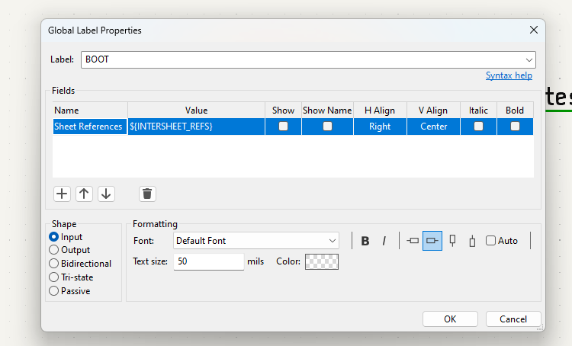
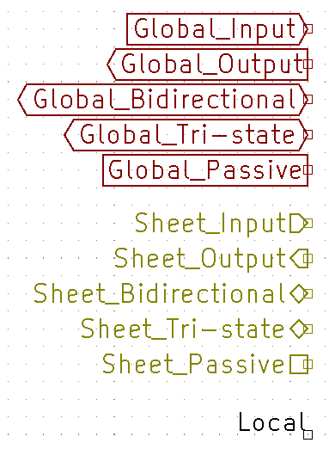
Hierarchical design – interfaces cont.
(like humans) Almost all pins have a type
Notes:
Why is this good.
It looks nice
Our schematic design rule checker can see if we connect e.g output2output and kill our board

Slide 31
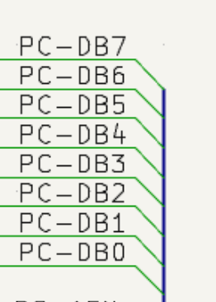
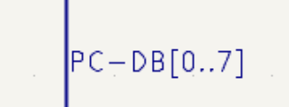

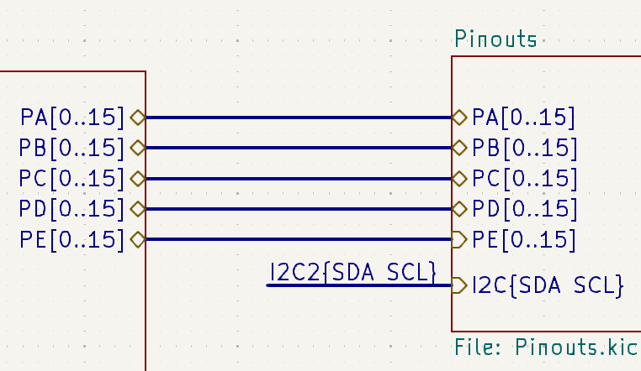
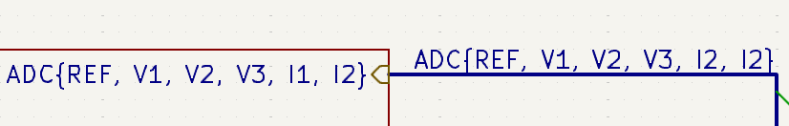
Vector / Group bus
Vector bus
Group bus
Source: https://docs.kicad.org/master/en/eeschema/eeschema.html#buses

Slide 32
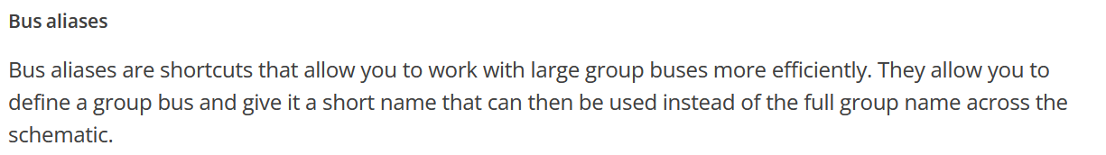
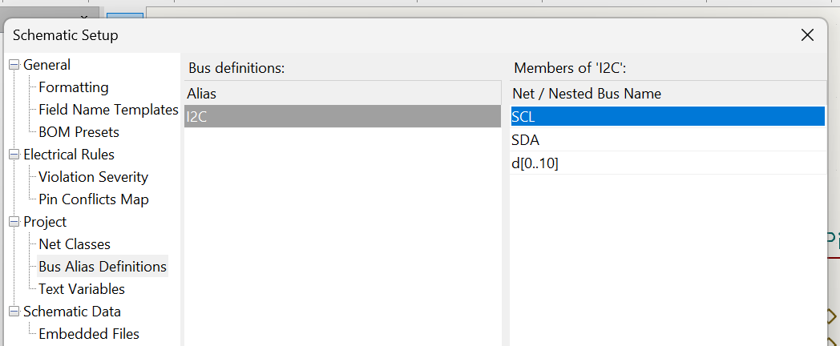
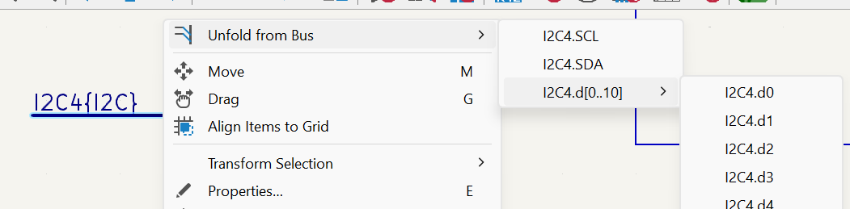
Vector / Group bus
Source: https://docs.kicad.org/master/en/eeschema/eeschema.html#buses

Slide 33
The Design rule checker <3
Our constraints
In house fabrication
JLC standard
DFM checker from kicad

Slide 34
Life saving plugins
Interactive HTML-BOM
JLC export
https://octopart.com/

Slide 35
Exercise: How to make s hield
You dont have to know everything, fortunately.
We’ve done some work for you.
https://github.com/aausat/a6hwcommon/tree/main/CommonDEVBoard/shield_template_rev1
kortlink.dk/2s42v

